Slide 1
Google Review Scraping
A use case for Aspect Based Opinion Mining
Let’s code!
Johann Philipp Sittinger, DA FT NOV22

Slide 2
What is Aspect Based Opinion Mining?
“Waiters are very friendly but the pasta is simply bad.”
 | Aspect | Opinion | Sentiment
1 | Waiters | Friendly | Positive
2 | Pasta | bad | Negative

Slide 3
Hornbach near me
Germany based hardware store
96 locations in Germany
Average reviews per market range from 3,8 to 4,3 stars
Main season: spring and late summer

Slide 4
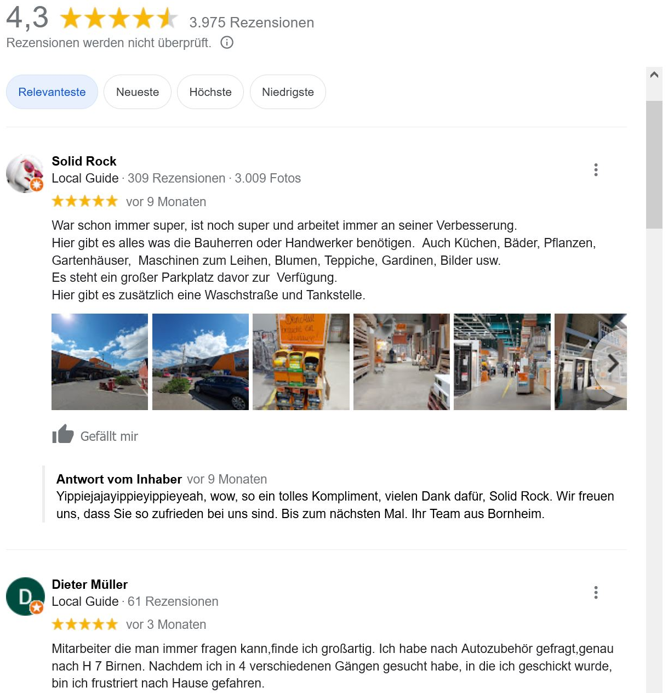
Hornbach near me

Slide 5

How to improve my reviews?
Mr. Hornbach:
We want to have a overview of the development of our 1-5 star reviews
Besides just the count, we want to know what exactly is bad and what’s good
Give us an overview for the key aspects we need to improve to get better reviews

Slide 6
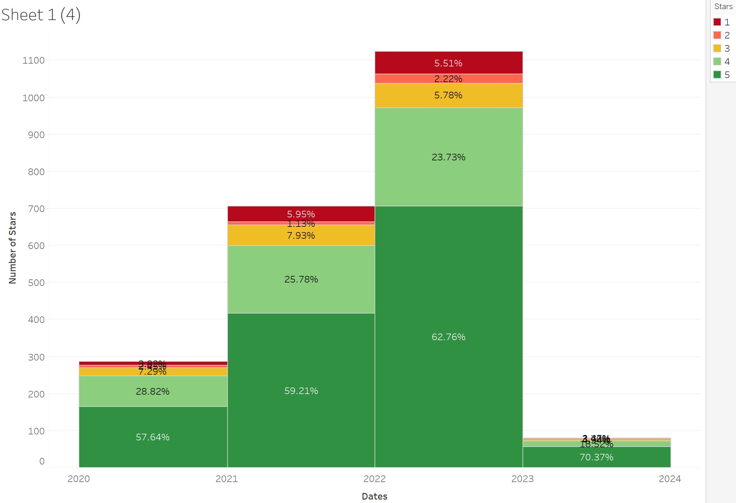
Distribution of stars per year
Number of reviews

Slide 7
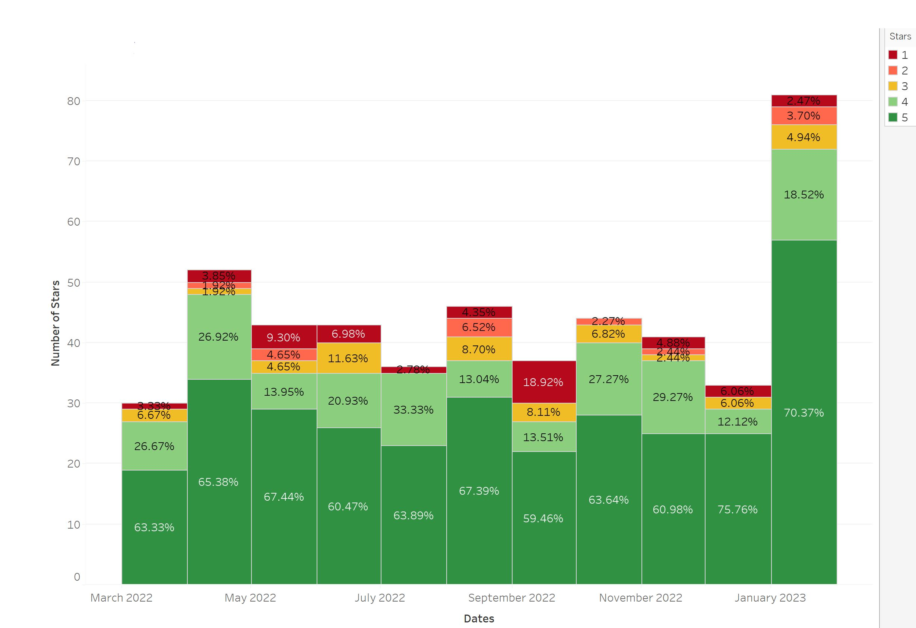
Distribution of stars per month
Number of reviews

Slide 8
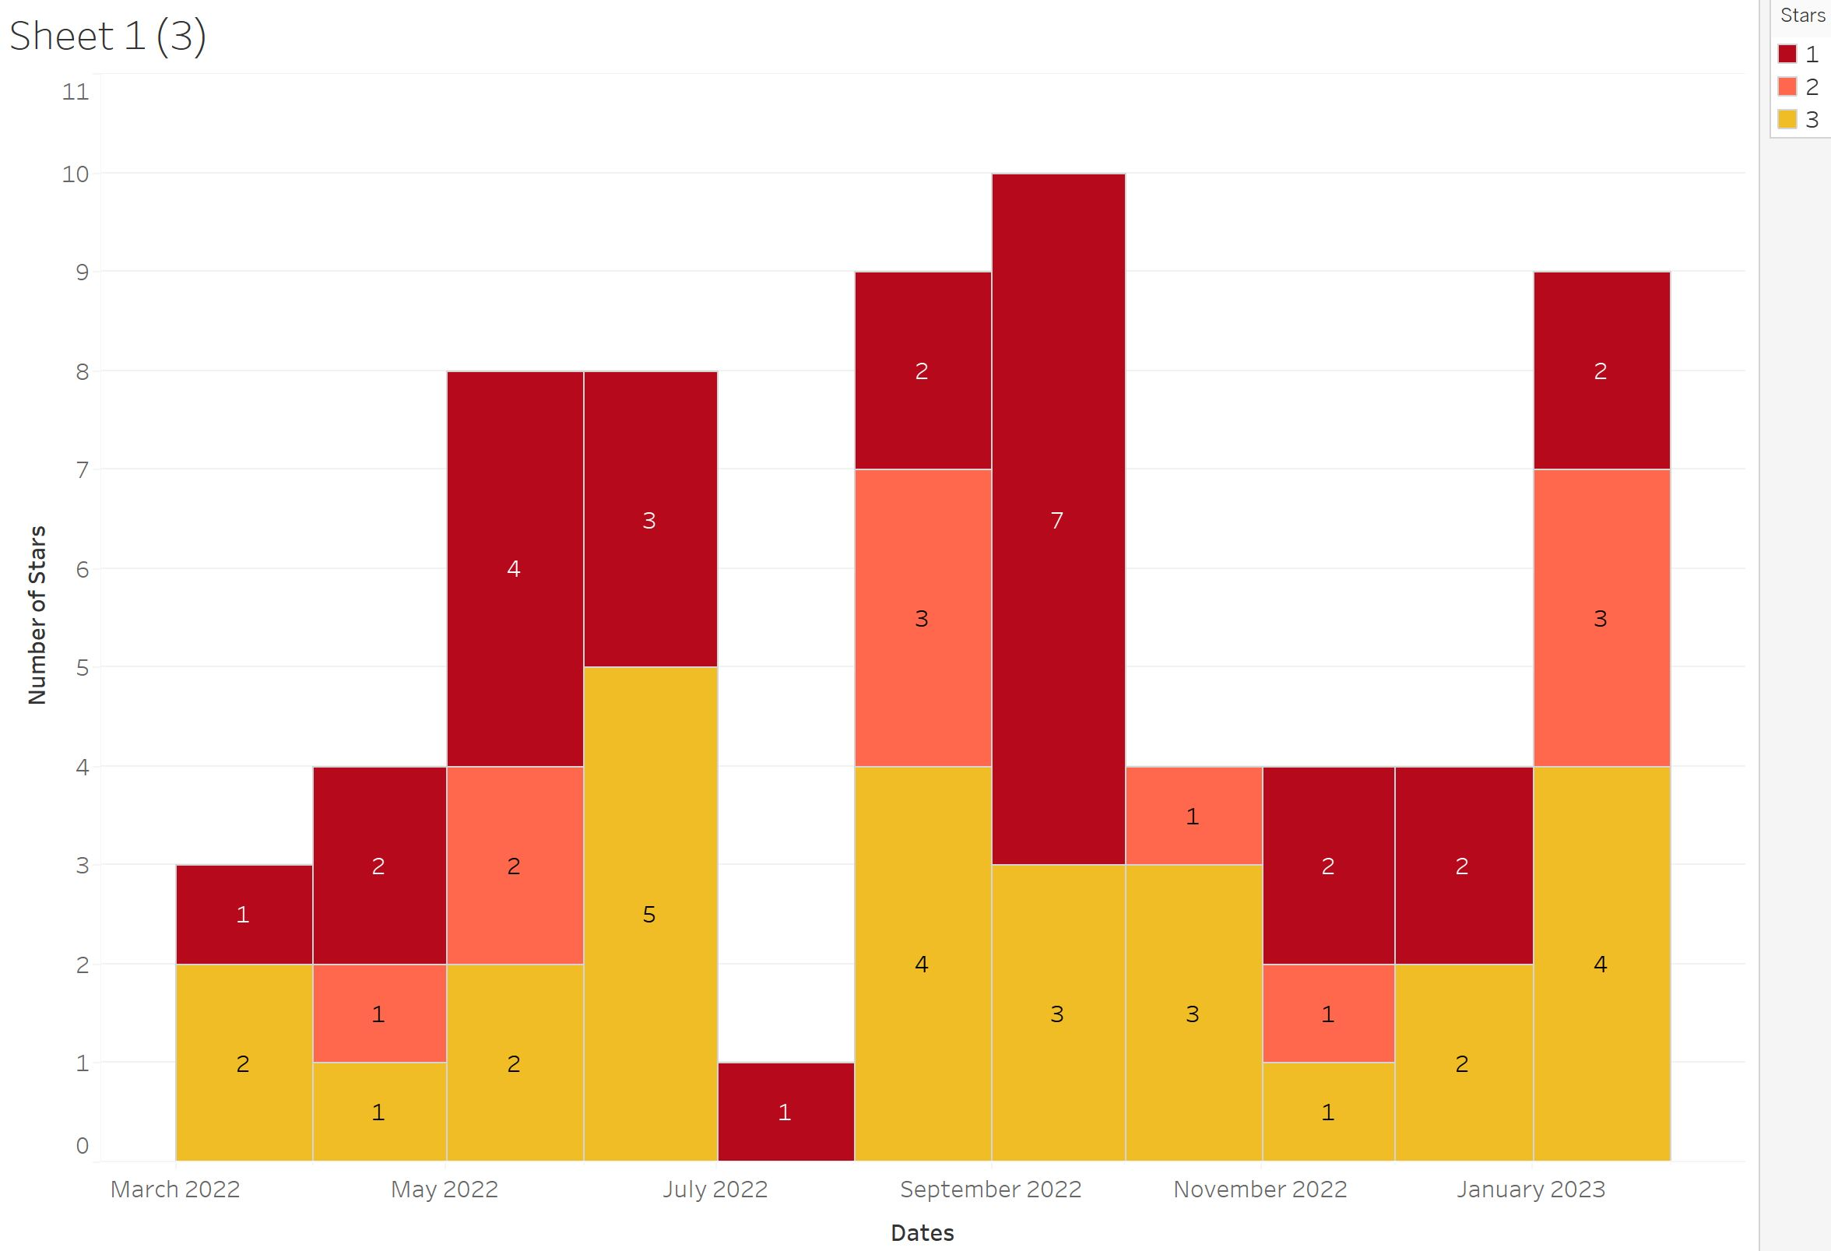
Only 1-3 star reviews

Slide 9
Methodology
Reviews
Understanding main topics and positive/negative influence
Preprocessing
Tokenizing
Stop Word Removal
Stemming
Aspects
Sentiment Analysis for each topic
Aspect Extraction

Slide 10
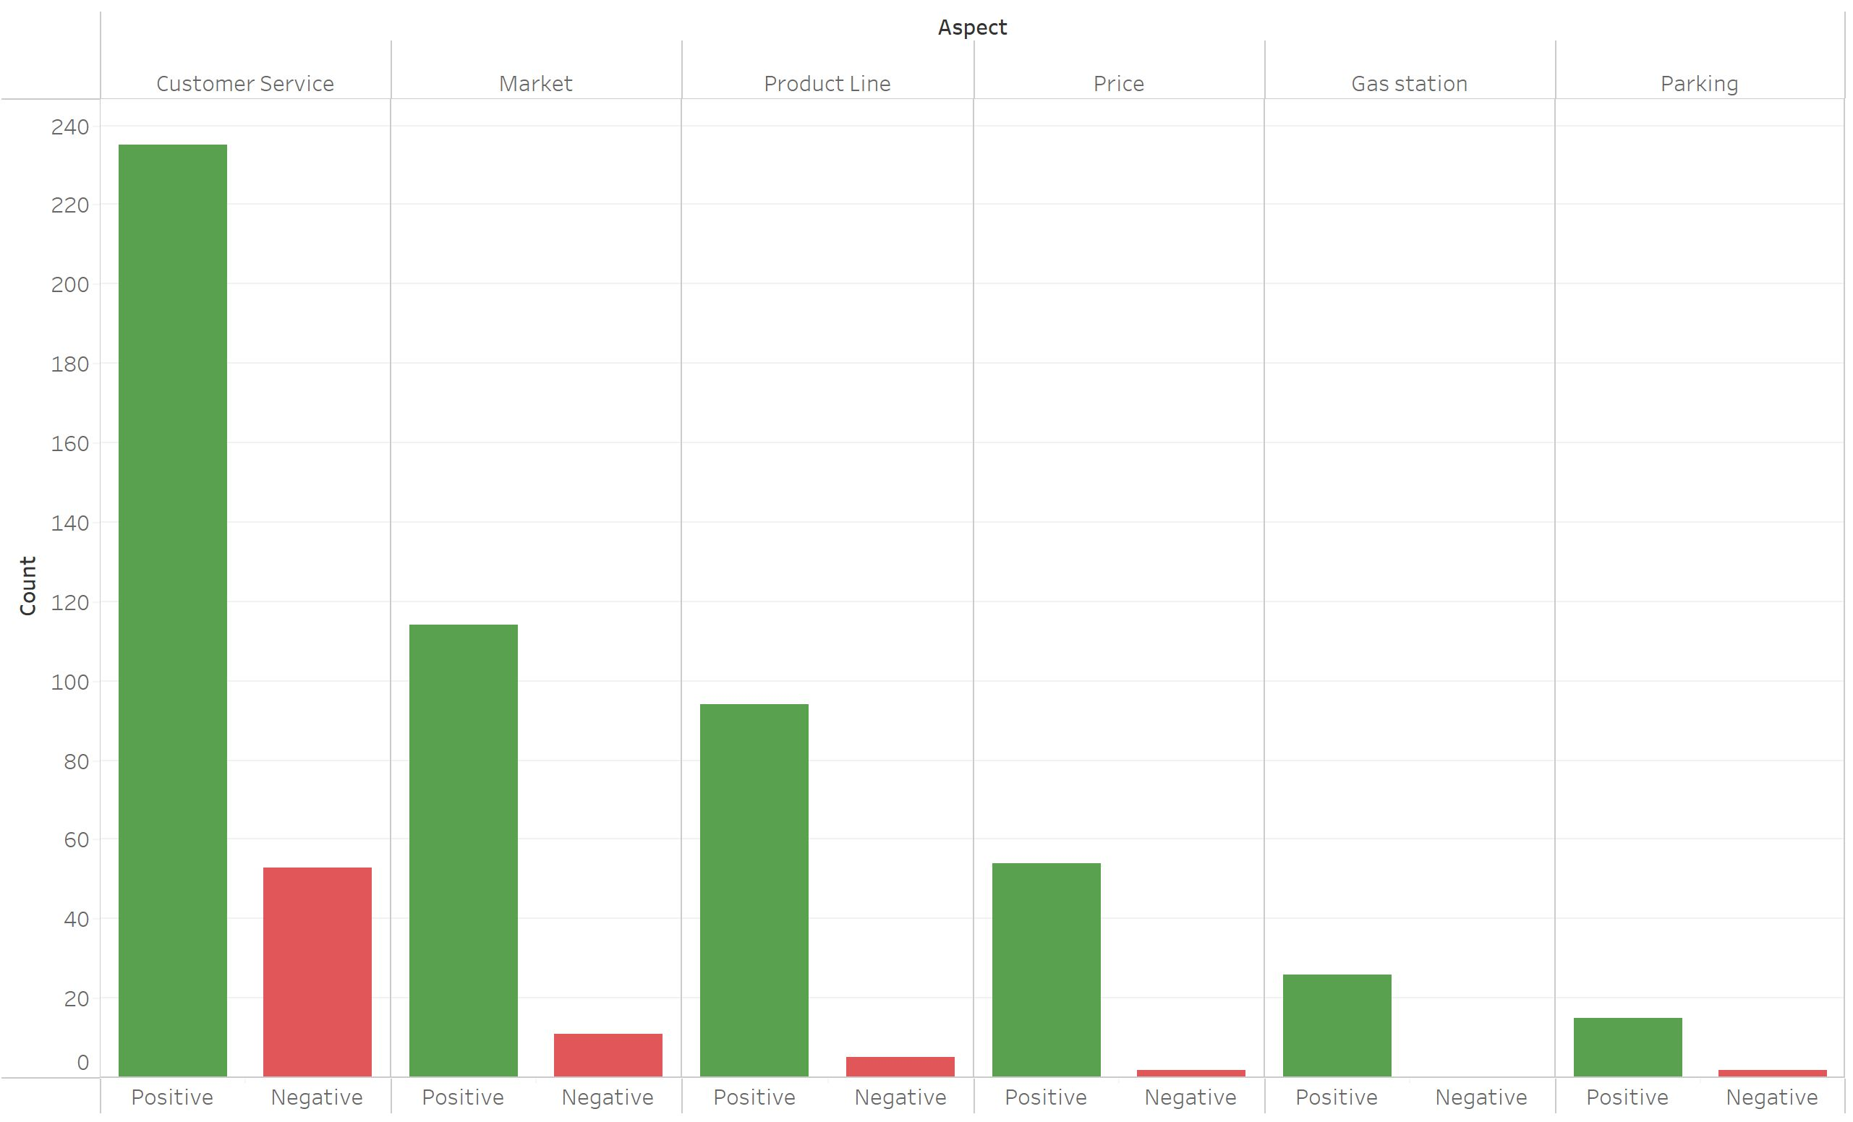
Top 6 aspects

Slide 11
Actionable insights
Mr. Hornbach, you could:
Around peak season (spring/late summer), there seem to be a peak in negative reviews
Given that the customer service is the most rated aspect and also the most highly negatively rated aspect: Staff training regarding service Increase staff in peak seasons
Also: Looking more closely onto the aspects that where assigned, the organization of the market and ease of finding the things you need could be improved. Suggestion: App to input what you’re searching outputting the direction via AR
Overall: On a good path! Increasing reviews every year, increasing 4-5 stars every year

Slide 12
How to finish presentation?
Questions?

